Slide 1
7
CHAPTER
FILES AND EXCEPTIONS
Slides by James Tam
Department of Computer Science,
University of Calgary
May 13, 2013

Slide 2
Chapter Goals
To read and write text files
To process collections of data
To process command line arguments
To raise and handle exceptions
In this chapter, you will learn how to write programs that manipulate files, a very useful skill for processing real world data.

Slide 3
Contents
Reading and Writing Text Files
Text Input and Output
Command Line Arguments
Binary files and random access (optional)
Exception Handling
Application: Handling Input Errors

Slide 4
7.1 Reading and Writing Text Files
Text Files are very commonly used to store information
They are the most ‘portable’ types of data files
Examples of text files include not only files that are created with a simple text editor, such as Windows Notepad, but also Python source code and HTML files.

Slide 5
Opening Files: Reading (1)
To access a file, you must first open it.
Suppose you want to read data from a file named input.txt, located in the same directory as the program.
To open a file for reading, you must provide the name of the file as the first argument to the open function and the string "r" as the second argument:
infile = open("input.txt", "r")

Slide 6
Opening Files: Reading (2)
Important things to keep in mind:
When opening a file for reading, the file must exist (and otherwise be accessible) or an exception occurs.
The file object returned by the open function must be saved in a variable. All operations for accessing a file are made via the file object.

Slide 7
Opening Files: Writing
To open a file for writing, you provide the name of the file as the first argument to the open function and the string "w" as the second argument:
If the output file already exists, it is emptied before the new data is written into it.
If the file does not exist, an empty file is created.
outfile = open("output.txt", "w")

Slide 8

Closing Files: Important
When you are done processing a file, be sure to close the file using the close() method:
If your program exits without closing a file that was opened for writing, some of the output may not be written to the disk file.
infile.close()
outfile.close()

Slide 9
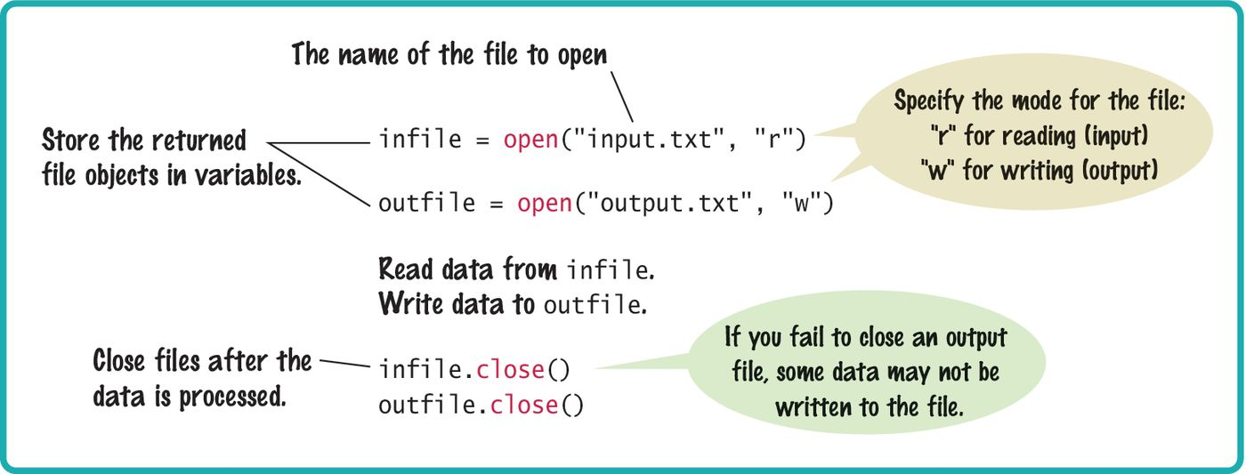
Syntax: Opening And Closing Files

Slide 10
Reading From A File (1)
To read a line of text from a file, call the readline() method with the file object that was returned when you opened the file:
When a file is opened, an input marker is positioned at the beginning of the file.
The readline() method reads the text, starting at the current position and continuing until the end of the line is encountered. The input marker is then moved to the next line.
line = infile.readline()

Slide 11
Reading From A File (2)
For example, suppose input.txt contains the lines
flying
circus
The first call to readline() returns the string "flying\n".
Recall that \n denotes the newline character that indicates the end of the line.
If you call readline() a second time, it returns the string "circus\n".

Slide 12
Reading From A File (3)
Calling readline() again yields the empty string "" because you have reached the end of the file.
If the file contains a blank line, then readline() returns a string containing only the newline character "\n".

Slide 13
Reading Multiple Lines From A File
You repeatedly read a line of text and process it until the sentinel value is reached:
The sentinel value is an empty string, which is returned by the readline() method after the end of file has been reached.
line = infile.readline()
while line != "" :
# Process the line.
line = infile.readline()

Slide 14
Converting File Input
As with the input function, the readline() method can only return strings.
If the file contains numerical data, the strings must be converted to the numerical value using the int() or float() function:
Note that the newline character at the end of the line is ignored when the string is converted to a numerical value.
value = float(line)

Slide 15
Writing To A File
For example, we can write the string "Hello, World!" to our output file using the statement:
Unlike print() when writing text to an output file, you must explicitly write the newline character to start a new line.
You can also write formatted strings to a file with the write method:
outfile.write("Hello, World!\n")
outfile.write("Number of entries: %d\nTotal: %8.2f\n"
% (count, total))

Slide 16
Example: File Reading/Writing (1)
Suppose you are given a text file that contains a sequence of floating-point values, stored one value per line.
You need to read the values and write them to a new output file, aligned in a column and followed by their total and average value.
If the input file has the contents
32.0
54.0
67.5
80.25
115.0

Slide 17
Example: File Reading/Writing (2)
The output file will contain
32.00
54.00
67.50
80.25
115.00
--------
Total: 348.75
Average: 69.75

Slide 18
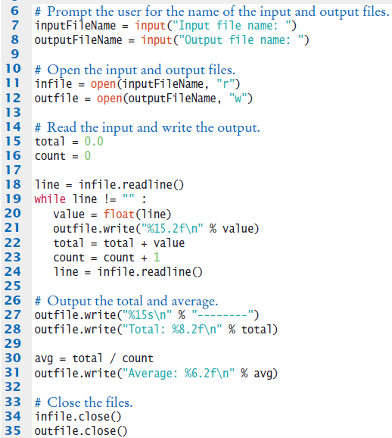
File Example: total.py (1)

Slide 19
File Example: total.py (2)

Slide 20

Common Error 7.1
Backslashes in File Names
When using a String literal for a file name with path information, you need to supply each backslash twice:
A single backslash inside a quoted string is the escape character, which means the next character is interpreted differently (for example, ‘\n’ for a newline character)
When a user supplies a filename into a program, the user should not type the backslash twice.
infile = open("c:\\homework\\input.txt", "r")

Slide 21
7.2 Text Input and Output
In the following sections, you will learn how to process text with complex contents, and you will learn how to cope with challenges that often occur with real data.
Reading Words Example:
Mary had a little lamb
input
for line in inputFile :
line = line.rsplit()
Mary
had
a
little
lamb
output

Slide 22
Processing Text Input
There are times when you want to read input by:
Each Word
Each Line
One Character
Python provides methods such: read(), split() and strip() for these tasks.
Processing input is required for almost all types of programs that interact with the user.

Slide 23
Text Input and Output
Python can treat an input file as though it were a container of strings in which each line comprises an individual string.
For example, the following loop reads all lines from a file and prints them:
At the beginning of each iteration, the loop variable line is assigned a string that contains the next line of text in the file.
for line in infile :
print(line)

Slide 24

Removing The Newline (1)
Recall that each input line ends with a newline (\n) character.
Generally, the newline character must be removed before the input string is used.
When the first line of the text file is read, the string line contains

Slide 25

Removing The Newline (2)
To remove the newline character, apply the rstrip() method to the string:
This results in the string:
line = line.rstrip()

Slide 26
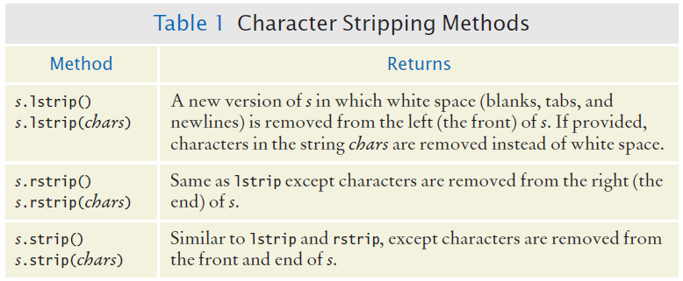
Character Strip Methods

Slide 27
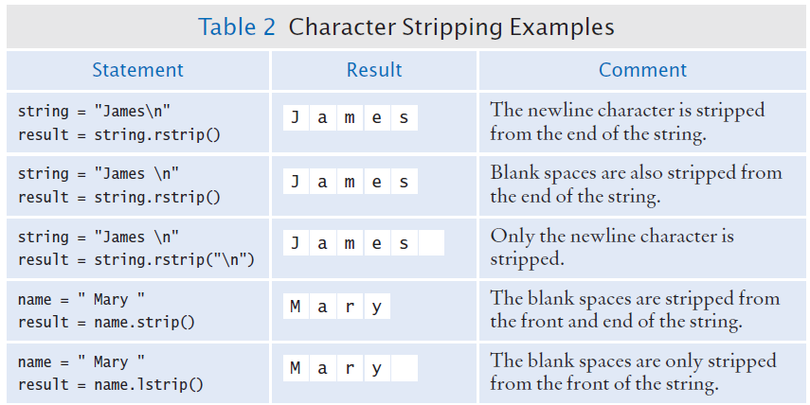
Character Strip Examples

Slide 28
Reading Words (1)
Sometimes you may need to read the individual words from a text file.
For example, suppose our input file contains two lines of text
Mary had a little lamb,
whose fleece was white as snow.

Slide 29
Reading Words (2)
We would like to print to the terminal, one word per line
Mary
had
a
little
. . .
Because there is no method for reading a word from a file, you must first read a line and then split it into individual words.
line = line.rstrip()

Slide 30
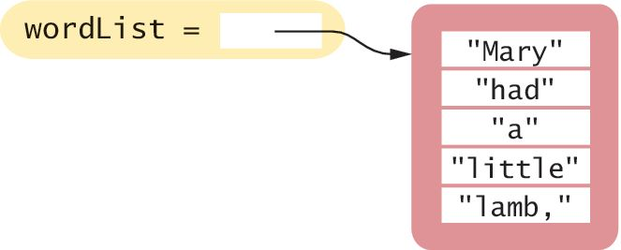
Reading Words (3)
The split method returns the list of substrings that results from splitting the string at each blank space.
For example, if line contains the string:
It will be split into 5 substrings that are stored in a list in the same order in which they occur in the string:

Slide 31
Reading Words (4)
Notice that the last word in the line contains a comma.
If we only want to print the words contained in the file without punctuation marks, then we can strip those from the substrings using the rstrip() method introduced in the previous section:
word = word.rstrip(".,?!")

Slide 32
Reading Words: Complete Example
inputFile = open("lyrics.txt", "r")
for line in inputFile :
line = line.rsplit()
wordList = line.split()
for word in wordList :
word = word.rstrip(".,?!")
print(word)
inputFile.close()

Slide 33
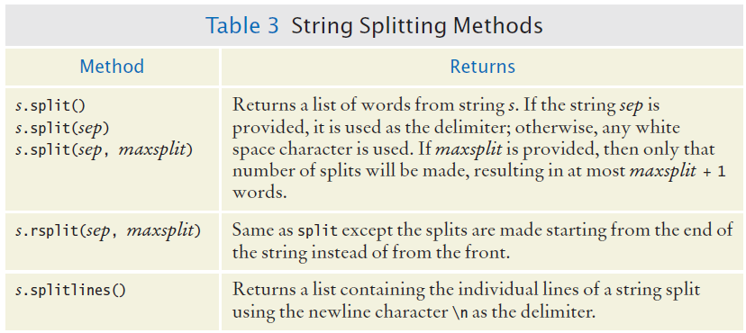
Additional String Splitting Methods

Slide 34
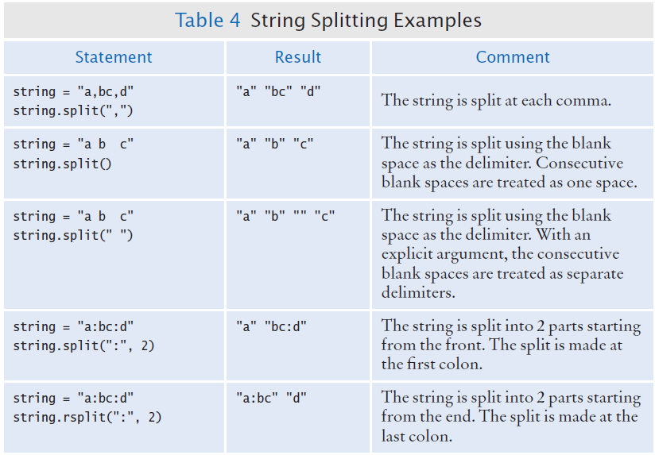
Additional String Splitting Examples

Slide 35
Reading Characters
The read() method takes a single argument that specifies the number of characters to read.
The method returns a string containing the characters.
When supplied with an argument of 1, the read() method returns a string consisting of the next character in the file.
If the end of the file is reached, it returns an empty string "".
char = inputFile.read(1)

Slide 36
Algorithm: Reading Characters
while char != "" :
Process character.
char = inputFile.read(1)

Slide 37
Reading Records
A text file can contain a collection of data records in which each record consists of multiple fields.
For example, a file containing student data may consist of records composed of an identification number, full name, address, and class year.
When working with text files that contain data records, you generally have to read the entire record before you can process it:
For each record in the file
Read the entire record.
Process the record.

Slide 38
Record Formats: Example 1
The organization or format of the records can vary, however, making some formats easier to read than others.
A typical format for such data is to store each field on a separate line of the file with all fields of a single record on consecutive lines:
China
1330044605
India
1147995898
United States
303824646
. . .

Slide 39
Record Formats: Example 1
Reading the data in this format is rather easy.
Because each record consists of two fields, we read two lines from the file for each record.
line = infile.readline()
while line != "" :
countryName = line.rstrip()
line = infile.readline()
population = int(line)
Process data record
line = infile.readline()

Slide 40
Record Formats: Example 2
Another common format stores each data record on a single line. If the record’s fields are separated by a specific delimiter : you can extract the fields by splitting the line with the split() method
China:1330044605
India:1147995898
United States:303824646
. . .

Slide 41
Record Formats: Example 3
But what if the fields are not separated by a delimiter?
China 1330044605
India 1147995898
United States 303824646
. . .
Because some country names have more than one word, we cannot simply use a blank space as the delimiter because multi-word names would be split incorrectly.

Slide 42
Record Formats: Example 3
One approach for reading records in this format is to read the line, then search for the first digit in the string returned by readline():
You can then extract the country name and population as substrings using the slice operator:
i = 0
char = line[0]
while not line[0].isdigit() :
i = i + 1
countryName = line[0 : i - 1]
population = int(line[i : ])

Slide 43
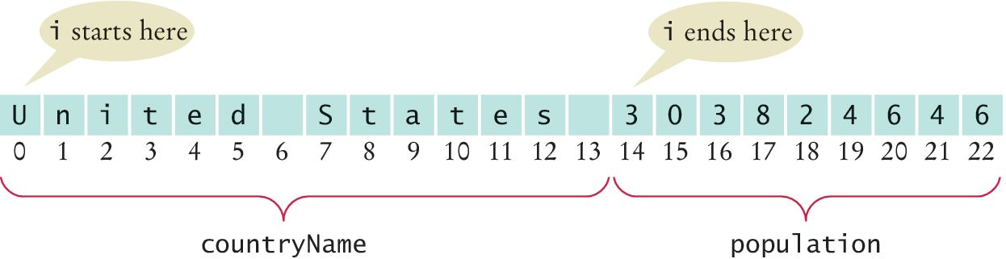
Record Formats: Example 3
‘Slicing’ the string read from file

Slide 44
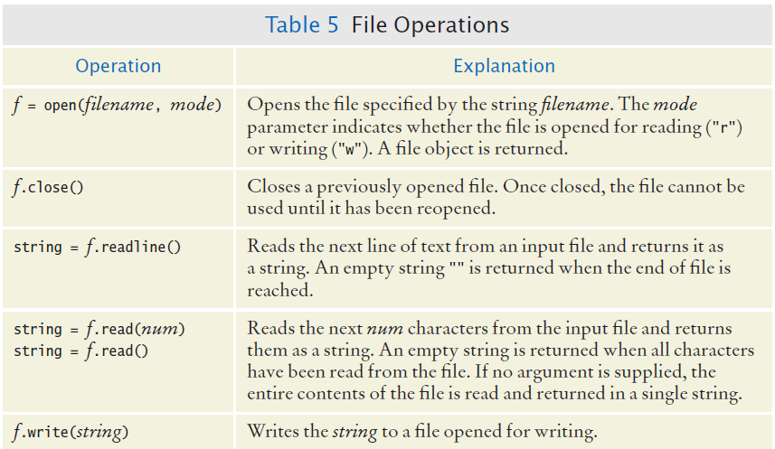
File Operations

Slide 45
7.3 Command Line Arguments
Text based programs can be ‘parameterized’ by using command line arguments
Filename and options are often typed after the program name at a command prompt:
Python provides access to them as a list of Strings as a parameter to the program ‘argv’, in this case main()
Options (switches) traditionally begin with a dash ‘-’
>python program.py -v input.dat
def main():
argv[0]: "program.py"
argv[1]: "-v"
argv[2]: "input.dat"

Slide 46
Caesar Cipher Example
Write a command line program that uses character replacement (Caesar cipher) to:
Encrypt a file provided input and output file names
Decrypt a file as an option
> python cipher.py input.txt encrypt.txt
> python cipher.py -d encrypt.txt output.txt

Slide 47
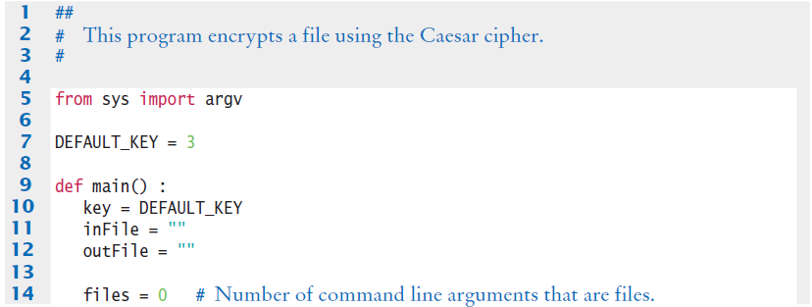
Cipher.py (1)

Slide 48
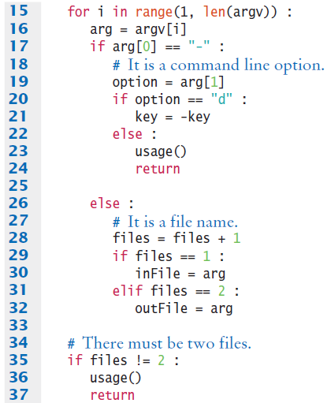
Cipher.py (2)
If the switch “-”is present, it is the first argument
Call the usage function to print helpful instructions

Slide 49
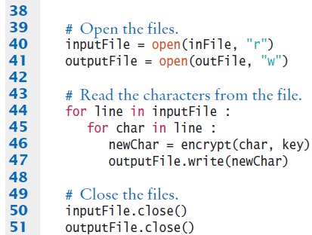
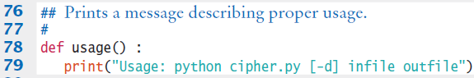
Cipher.py (3)
Process the input file one character at a time
Don’t forget the close the files!
Example of a ‘usage’ function

Slide 50
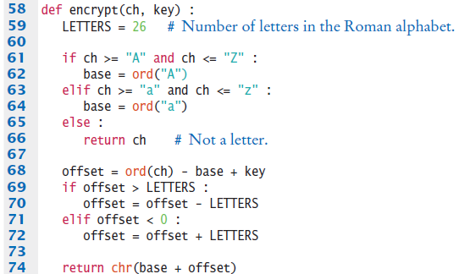
Cipher.py (4)
Function that encrypts the text using the Caesar cipher

Slide 51
Steps to Processing Text Files
Read two country data files, worldpop.txt and worldarea.txt.
Write a file world_pop_density.txt that contains country names and population densities with the country names aligned left and the numbers aligned right.
Afghanistan 50.56
Akrotiri 127.64
Albania 125.91
Algria 14.18
American Samoa 288.92
. . .

Slide 52
Steps to Processing Text Files
1) Understand the Processing Task
-- Process ‘on the go’ or store data and then process?
2) Determine which files you need to read and write.
3) Choose a mechanism for obtaining the file names.
4) Choose between iterating over the file or reading individual lines.
-- If all data is on one line, normally use line input
5) With line-oriented input, extract required data
-- Examine the line and plan for whitespace, delimiters…
6) Use functions to factor out common tasks

Slide 53
Processing Text Files: Pseudocode
Afghanistan 50.56
Akrotiri 127.64
Albania 125.91
Algria 14.18
American Samoa 288.92
Step 1: Understand the Task
While there are more lines to be read
Read a line from each file
Extract the country name
population = number following the country name in the line from the first file
area = number following the country name in the line from the second file
If area != 0
density = population / area
Print country name and density
(The other steps either don‘t require pseudo code or were covered previously).

Slide 54
7.4 Binary Files and Random Access (Optional)
Text files
Data items are represented in human-readable form as a sequence of characters.
For example, in text form, the integer 12,345 is stored as the sequence of five characters:
"1" "2" "3" "4" "5“
Binary files
Data items are represented in bytes. A byte is composed of 8 bits, each of which can be 0 or 1.
For example, the integer 123,456 can be stored as
64 226 1 0
(because 123,456 = 64 + 226 · 256 + 1 · 256²).

Slide 55
More On Binary Files
Efficient: as you can see from our example, it takes fewer bytes than digits to store an integer.
If you load a binary file into a text editor, you will not be able to view its contents.
Files containing images and sounds usually store their information in binary format.
Processing binary files requires programs written explicitly for reading or writing the binary data.

Slide 56
Opening Binary Files
Reading from a binary file
Writing to a binary file
inFile = open(filename, "rb")
inFile = open(filename, "wb")

Slide 57
Reading From Binary Files (1)
With a binary file, you don’t read strings of text but rather the individual bytes.
For example, you read four bytes with the call
The byte value returned by this function is stored in a bytes sequence type.
The elements in a bytes sequence are integer values between 0 and 255.
To use the byte value itself, you must retrieve it from the bytes sequence using the subscript operator (just as if it were stored in a list):
theBytes = inFile.read(4)
value = theBytes[0]

Slide 58
Reading From Binary Files (2)
If you want to read a single byte, you can combine these two steps into a single operation:
value = inFile.read(1)[0]

Slide 59
Writing To Binary Files
You write one or more bytes to a binary file using the write() method.
The method requires a bytes sequence as its argument.
To create the sequence, you use the bytes function with a list argument that contains the individual values:
theBytes = bytes([64, 226, 1, 0])
outFile.write(theBytes)

Slide 60

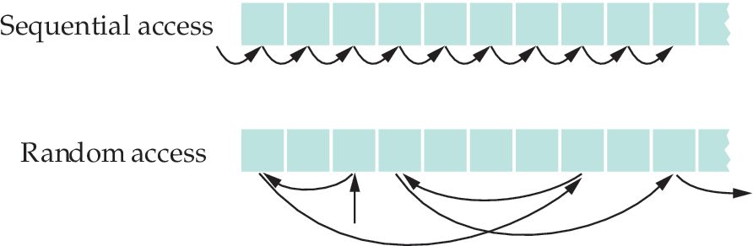
Random Access (1)
Sequential access: reading from a file one string at a time and written to a file one string at a time, without skipping forward or backward.
Random access: read and modify any item stored at any location in the file.
Each file has a special marker that indicates the current position within the file

Slide 61
Random Access (2)
The file marker is used to determine where the next string is read or written.
You can move the file marker to a specific position within the file.
To position the marker relative to the beginning of the file, you use the method call:
To determine the current position of the file marker:
inFile.seek(position)
inFile.seek(4, SEEK_CUR) # Move forward four bytes.
inFile.seek(-3, SEEK_CUR) # Move backward three bytes.
position = inFile.tell() # Get current position.

Slide 62
Image Files: BMP (1)
You will learn about the file format for 24-bit True Color Images BMP image files.
The BMP format is quite simple because it does not use data compression.
As a consequence, BMP files are huge and you will rarely find them in the wild.
However, image editors can convert any image into BMP format.

Slide 63
Image Files: BMP (2)
Each pixel is represented as a sequence of three bytes, one each for the blue, green, and red value.
cyan (a mixture of blue and green) is 255 255 0,
red is 0 0 255
medium gray is 128 128 128.

Slide 64
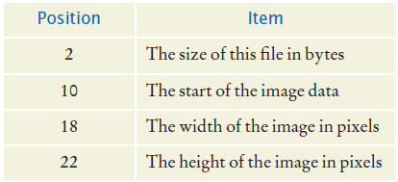
BMP Headers
A BMP file starts with a header that contains various pieces of information.
We only need the following items:

Slide 65
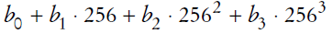
Reading From BMP Files
To read an integer from a BMP file, you need to read four bytes (b0, b1, b2, b3) and combine them into a single integer value using the equation:
The Python code for this task
theBytes = inFile.read(4) # Read the 4 bytes.
result = 0 # Store the resulting integer.
base = 1
# Iterate through the sequence and compute the integer.
for i in range(4) :
result = result + theBytes[i] * base
base = base * 256

Slide 66
Format of BMP Files (1)
The image is stored as a sequence of pixel rows, starting with the pixels in the bottommost row of the image.
Each pixel row contains a sequence of blue/green/red triplets.
The end of the row is padded with additional bytes so that the number of bytes in the row is divisible by 4 (see following image on next slide).

Slide 67
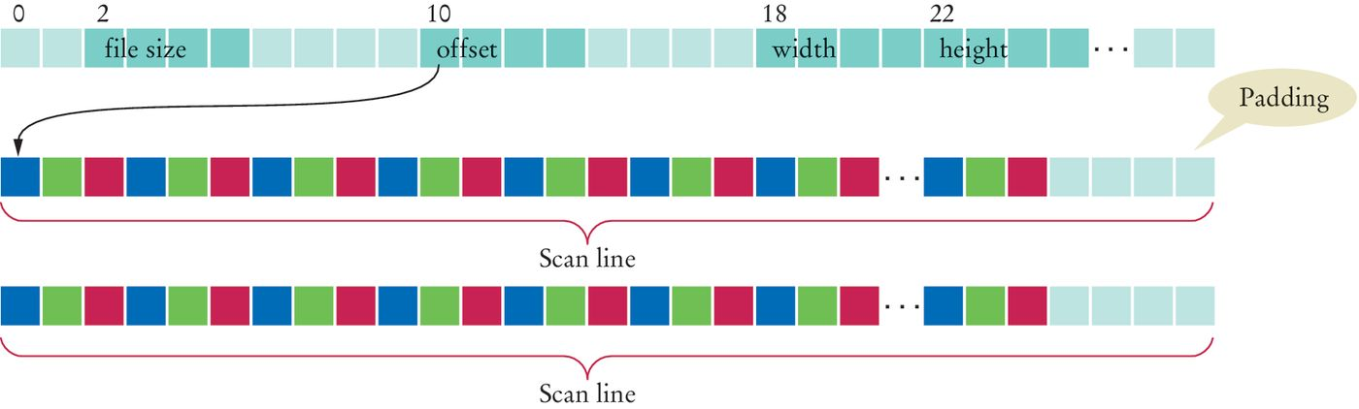
Format of BMP Files (2)

Slide 68
Reading/Displaying BMP Images (1)
The graphics module provided with your book can be used to create an image window that displays a digital image. To create the window, you use the command:
This creates a window with a blank image of size width × height.
imgWin = ImageWindow(width, height)

Slide 69
Reading/Displaying BMP Images (2)
The individual pixels of the image can be set to a specific color using the setPixel() method.
For example, to set the pixel in row 0, column 10 (counting from the top and left edges) to red, use these statements:
row = 0
col = 10
red = 255
green = 0
blue = 0
imgWin.setPixel(row, col, red, green, blue)

Slide 70

Drawtriangle.py
This program creates an image of a red and a green triangle:
from graphics import ImageWindow
imgWin = ImageWindow(200, 200)
for row in range(200) :
for col in range(0, row) :
imgWin.setPixel(row, col, 255, 0, 0)
imgWin.setPixel(200 - row, 200 - col, 0, 255, 0)
imgWin.wait()

Slide 71
Viewimg.py (1)
To display a BMP image file, we need to load the byte values for each pixel in the image from the file and set the corresponding pixel in the image window.
To begin the process, we open the binary file for reading and extract the necessary header information:
imgFile = open(filename, "rb")
# Extract the image information.
fileSize = readInt(imgFile, 2)
start = readInt(imgFile, 10)
width = readInt(imgFile, 18)
height = readInt(imgFile, 22)

Slide 72
Viewimg.py (2)
The readInt() function is a version of the algorithm introduced earlier for converting four successive bytes to an integer:
def readInt(imgFile, offset) :
# Move the file pointer to the given byte within the
# file.
imgFile.seek(offset)
# Read the 4 individual bytes and build an integer.
theBytes = imgFile.read(4)
result = 0
base = 1
for i in range(4) :
result = result + theBytes[i] * base
base = base * 256
return result

Slide 73
Viewimg.py (3)
The start value indicates the location of the first byte of the first pixel.
To extract the individual bytes, we must move the marker to that position.
imgFile.seek(start)

Slide 74
Viewimg.py (4)
Now the individual pixels can be extracted and set in the image window:
# The pixels are read starting with the bottom row.
for row in range(height - 1, -1, -1) :
for col in range(width) :
# Read the pixel bytes.
theBytes = imgFile.read(3)
blue = theBytes[0]
green = theBytes[1]
red = theBytes[2]
# Set the corresponding pixel in the image
# window.
imgWin.setPixel(row, col, red, green, blue)
# Skip the padding at the end of the row
imgFile.seek(padding, SEEK_CUR)

Slide 75
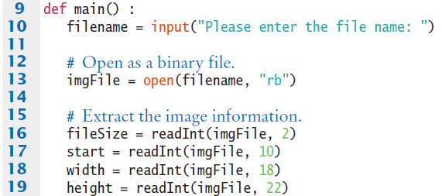
Viewimg.py: Complete Program (1)

Slide 76
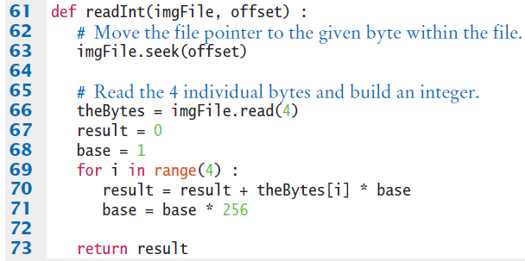
Viewimg.py: Complete Program (2)

Slide 77
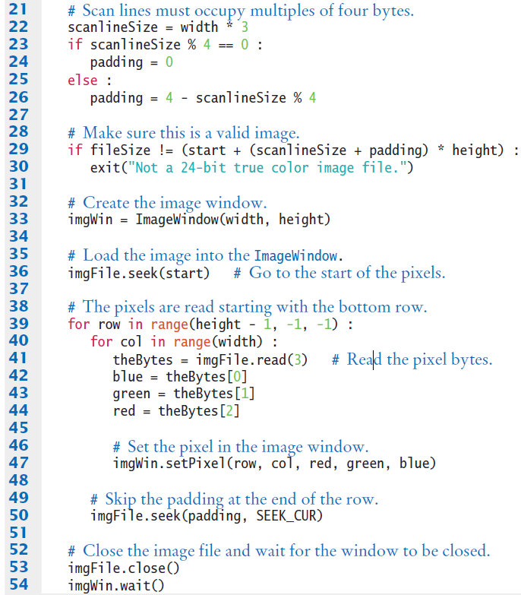
Viewimg.py: Complete Program (3)

Slide 78
Viewimg.py: Complete Program (4)

Slide 79
Processing Image Files (1)
Often it can be useful to make changes to the image that is currently viewed.
A file can be opened for both reading and writing using the open function with a plus (+) character in the mode string:
Manipulations can require the use of filters or algorithms that adjust or modify pixel values.
binFile = open(filename, "rb+")

Slide 80

Processing Image Files (2)
The following is a filter applied to a digital image that replaces an image with its negative.
That is, turning white pixels to black, cyan to red, and so on. The result is a negative image of the kind that old-fashioned film cameras used to produce.
Original image
Negative version

Slide 81
Processing Image Files (3)
To create the negative of a BMP image, you must extract the blue/green/red component values for each pixel
and adjust the values them using the equations:
theBytes = imgFile.read(3)
blue = theBytes[0]
green = theBytes[1]
red = theBytes[2]
newBlue = 255 - blue
newGreen = 255 - green
newRed = 255 - red

Slide 82
Processing Image Files (4)
After the pixels have been adjusted, the new values have to be written back to the file at the same location from which they were read:
# Go back 3 bytes to the start of the pixel.
imgFile.seek(-3, SEEK_CUR)
imgFile.write(bytes([newBlue, newGreen, newRed]))

Slide 83
7.5 Exception Handling
There are two aspects to dealing with run-time program errors:
Detecting Errors
Handling Errors

Slide 84
Detecting Errors (1)
This is the easy part. You can ‘raise’ an exception.
Use the raise statement to signal an exception
if amount > balance :
raise ValueError("Amount exceeds balance")

Slide 85
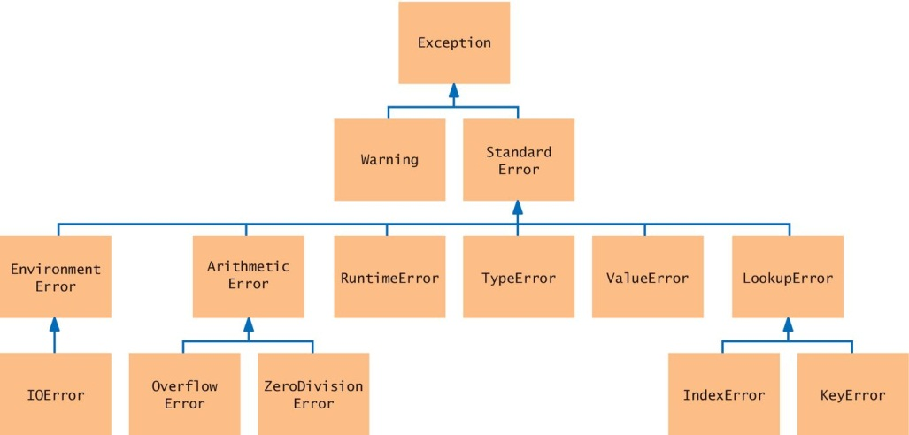
Detecting Errors (2)
Look for an appropriate exception.

Slide 86
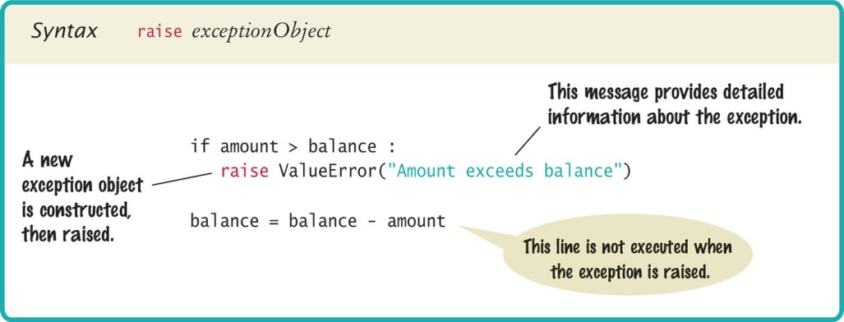
Syntax: Raising an Exception

Slide 87
Handling Exceptions
This is more complex. You need to handle each possible exception and react to it appropriately
Handling recoverable errors can be done:
Simply: exit the program
User-friendly: Ask the user to correct the error

Slide 88
Handling Exceptions: Try-Except
You handle exceptions with the try/except statement.
Place the statement into a location of your program that knows how to handle a particular exception.
The try block contains one or more statements that may cause an exception of the kind that you are willing to handle.
Each except clause contains the handler for an exception type.

Slide 89
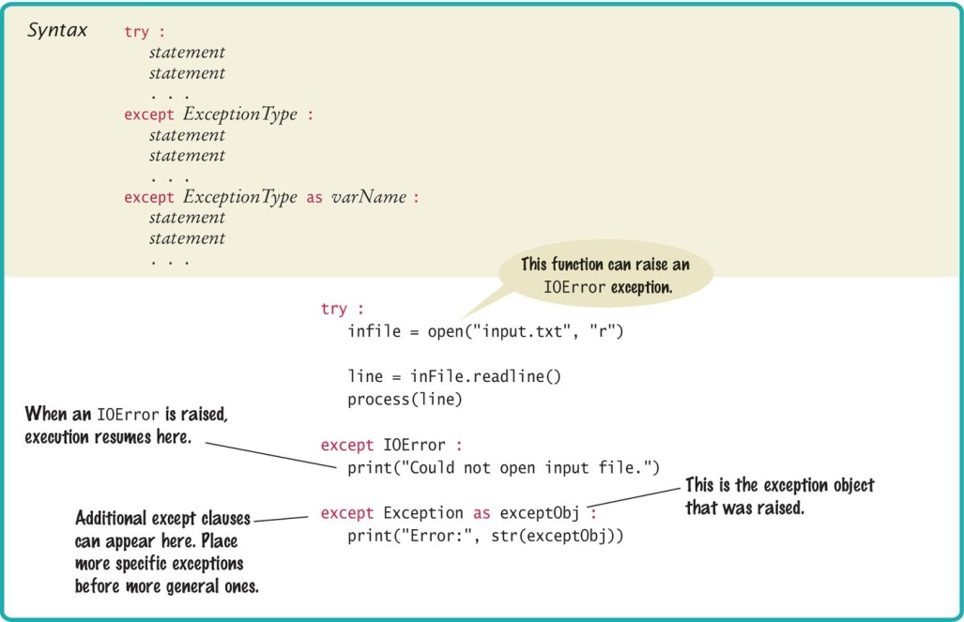
Syntax: Try-Except

Slide 90
Try-Except: An Example
try :
filename = input("Enter filename: ")
infile = open(filename, "r")
line = infile.readline()
value = int(line)
. . .
except IOError :
print("Error: file not found.")
except ValueError as exception :
print("Error:", str(exception))
open() can raise an IOError exception
int() can raise a ValueError exception
Execution transfers here if file cannot be opened
Execution transfers here if the string cannot be converted to an int
If either of these exceptions is actually raised, then the rest of the instructions in the
try block are skipped.

Slide 91
Output Messages (1)
When the body of this handler is executed, it prints the message included with the exception.
For example, if the string passed to the int() function was "35x2", then the message included with the exception will be:
invalid literal for int() with base 10: '35x2'
except ValueError as exception :
print("Error:", str(exception))

Slide 92
Output Messages (2)
To obtain the message, we must have access to the exception object itself.
You can store the exception object in a variable with the as syntax:
When the handler for ValueError is executed, exception is set to the exception object. In our code, we then obtain the message string by calling str(exception).
except ValueError as exception :

Slide 93
Source of Output Messages
When you raise an exception, you can provide your own message string. For example, when you call
the message of the exception is the string provided as the argument to the constructor.
raise ValueError("Amount exceeds balance")

Slide 94
The Finally Clause
The finally clause is used when you need to take some action whether or not an exception is raised.
Here is a typical situation.
It is important to always close an output file whether or not an exception was raised (to ensure that all output is written to the file).
Place the call to close() inside a finally clause:
outfile = open(filename, "w")
try :
writeData(outfile)
finally :
outfile.close()

Slide 95
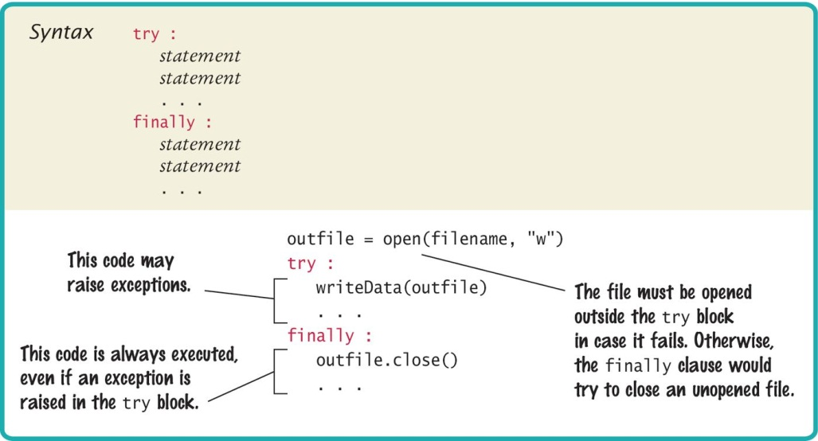
Syntax: The Finally Clause

Slide 96

Programming Tip 7.1
Throw Early
When a method detects a problem that it cannot solve, it is better to throw an exception rather than try to come up with an imperfect fix.
Catch Late
Conversely, a method should only catch an exception if it can really remedy the situation.
Otherwise, the best remedy is simply to have the exception propagate to its caller, allowing it to be caught by a competent handler.

Slide 97
Programming Tip 7.2
Do not use except and finally in the same try block
The finally clause is executed whenever the try block is exited in any of three ways:
1. After completing the last statement of the try block
2. After completing the last statement of a except clause, if this try block caught an exception
3. When an exception was raised in the try block and not handled
try
except
finally

Slide 98

Programming Tip 7.2
It is better to use two (nested) try clauses to control the flow
try
try :
outfile = open(filename, "w")
try :
# Write output to outfile
finally :
out.close() # Close resources
except IOError :
# Handle exception
try
finally
except

Slide 99
The With Statement
Because a try/finally statement for opening and closing files is so common, Python has a special shortcut:
This with statement opens the file with the given name, sets outfile to the file object, and closes the file object when the end of the statement has been reached or an exception was raised.
with open(filename, "w") as outfile :
Write output to outfile.

Slide 100
7.6 Handling Input Errors
File Reading Application Example
Goal: Read a file of data values
First line is the count of values
Remaining lines have values
Risks:
The file may not exist
The open() function will raise an exception when the file does not exist.
The file might have data in the wrong format.
When there are fewer data items than expected, or when the file doesn’t start with the count of values, the program will raise a ValueError exception.
Finally, when there are more inputs than expected, a RuntimeError exception should be raised.
3
1.45
-2.1
0.05

Slide 101
Handling Input Errors: main()
Outline for method with all exception handling
done = False
while not done :
try:
# Prompt user for file name
data = readFile(filename) # May raise exceptions
# Process data
done = true;
except IOError:
print("File not found.")
except ValueError :
print("File contents invalid.")
except RuntimeError as error:
print("Error:", str(error))

Slide 102
Handling Input Errors: readFile()
Creates the file object and calls the readData() function.
No exception handling (no except clauses)
finally clause closes file in all cases (exception or not)
def readFile(filename) :
inFile = open(filename, "r") # May throw exceptions
try
return readData(inFile)
finally
in.close()

Slide 103
Handling Input Errors: readData()
No exception handling (no try or except clauses)
raise creates an ValueError exception and exits
RuntimeError exception can occur
def readData(inFile) :
line = inFile.readline()
numberOfValues = int(line) # May raise a ValueError exception.
data = []
for i in range(numberOfValues) :
line = inFile.readline()
value = int(line) # May raise a ValueError exception.
data.append(value)
# Make sure there are no more values in the file.
line = inFile.readline()
# Extra data in file
if line != "" :
raise RuntimeError("End of file expected.")
return data

Slide 104
Summary: File Input/Output
When opening a file, you supply the name of the file stored on disk and the mode in which the file is to be opened.
Close all files when you are done processing them.
Use the readline() method to obtain lines of text from a file.
Write to a file using the write() method or the print() function.

Slide 105
Summary: Processing Text Files
You can iterate over a file object to read the lines of text in the file.
Use the rstrip() method to remove the newline character from a line of text.
Use the split() method to split a string into individual words.
Read one or more characters with the read() method.

Slide 106
Command Line Arguments
Programs that start from the command line receive the command line arguments in the argv list defined in the sys module.

Slide 107
Binary File Input/Output
To open a binary file for reading, use the mode string "rb"; to open it for writing, use the mode string "wb".
You can access any position in a random access file by moving the file marker prior to a read or write operation.
Different types image of files use different layouts for the image information and pixel values.
Binary files, like other files, can be opened for both reading and writing.

Slide 108
Summary: Exceptions (1)
To signal an exceptional condition, use the raise statement to raise an exception object.
When you raise an exception, processing continues in an exception handler.
Place the statements that can cause an exception inside a try block, and the handler inside an except clause.
Once a try block is entered, the statements in a finally clause are guaranteed to be executed, whether or not an exception is raised.

Slide 109
Summary: Exceptions (2)
Raise an exception as soon as a problem is detected. Handle it only when the problem can be handled.
When designing a program, ask yourself what kinds of exceptions can occur.
For each exception, you need to decide which part of your program can competently handle it.

